Slide 1
Computational Geometry
The systematic study of algorithms and data structures for
geometric objects, with a focus on exact algorithms that are
asymptotically fast.
Two key ingredients of a good algorithmic solution:
♦ Thorough understanding of the problem geometry.
♦ Proper application of algorithmic techniques
and data structures.
Com S 418 (prereq. Com S 311, offered in Spring 2018 by Dr. Jia)
http://www.cs.iastate.edu/~cs518/

Slide 2
Proximity
Closest café on campus?
bisector
Delaunay triangulation
Voronoi diagram

Slide 3
Path Planning
How can a robot find a short route to the destination that
avoids all obstacles?
Robot

Slide 4
The Art Gallery Problem
camera
How many cameras are needed to guard a gallery and
Where should they be placed?

Slide 5

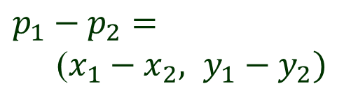
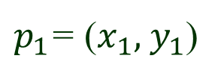
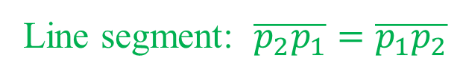
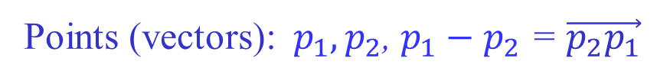

Line Segments & Vectors
y
$p_{1}$= ($x_{1}, { y}_{1}$)
$p_{1}−p_{2}$ $=$
($x_{1}−x_{2}, y_{1}−y_{2})$
$$p_{2}= (x_{2} , y_{2})$$
$$O = (0, 0)$$
x
Points (vectors):${ p}_{1}, p_{2}$, $p_{1}−p_{2}$ = $\vec{p_{2}p_{1}}$
Line segment: $\overline{p_{2}p_{1}}=\overline{p_{1}p_{2}}$

Slide 6
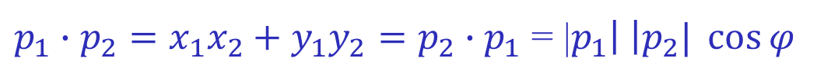






Dot (Inner) Product
$$y$$
$$p_{2}$$
$$φ$$
$$p_{1}$$
$(0, 0)$
$$x$$
$p_{1}∙p_{2}=x_{1}x_{2}+y_{1}y_{2}=p_{2}∙p_{1}$ = |$p_{1}\left| \right|p_{2}| \cos{φ}$

Slide 7
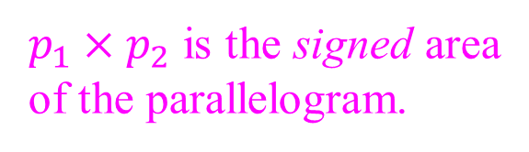




Cross (Vector) Product
$$y$$
$$p_{1}+p_{2}$$
$$p_{2}$$
$p_{1}×p_{2}$ is the signed area
of the parallelogram.
$$φ$$
$$p_{1}$$
$$(0, 0)$$
$$x$$
$p_{1}×p_{2}=x_{1}y_{2}−x_{2}y_{1}=−p_{2}×p_{1}=$|$p_{1}\left| \right|p_{2}| \sin{φ}$
$p_{1}$ and $p_{2}$ are collinear with the origin iff $p_{1}×p_{2}=$ $0$.

Slide 8












Turning of Consecutive Segments
Segments $\overline{p_{0}p_{1}}$ and $\overline{p_{1}p_{2}}$. Move from $p_{0}$ to $p_{1}$ then to $p_{2}$.
$$p_{2}$$
$$p_{2}$$
$$p_{1}$$
$$p_{2}$$
$$p_{1}$$
$$p_{1}$$
$$p_{0}$$
$$p_{0}$$
$$p_{0}$$
Counterclockwise Clockwise Turn of 0 or $π$
$$\vec{p_{0}p_{1}}×\vec{p_{1}p_{2}}>0$$
$\vec{p_{0}p_{1}}×\vec{p_{1}p_{2}}$ $< 0$
$$\vec{p_{0}p_{1}}×\vec{p_{1}p_{2}}= 0$$

Slide 9





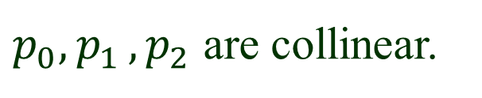




Collinear Points
$$\vec{p_{0}p_{1}}×\vec{p_{1}p_{2}}= 0$$
$p_{0}{, p}_{1}{, p}_{2}$ are collinear.
$$p_{2}$$
$$p_{1}$$
$$p_{1}$$
$$p_{2}$$
$$p_{0}$$
$$p_{0}$$
No change of direction Direction reversal
$$\vec{p_{0}p_{1}}∙\vec{p_{1}p_{2}}>0$$
$\vec{p_{0}p_{1}}∙\vec{p_{1}p_{2}}$ $< 0$

Slide 10




Polar Angle
$$y$$
$$q$$
polar angle
p
$$x$$
$$r$$

Slide 11






Convex Sets & Concave Sets
A planar region $R$ is called convex if for any pair of points
$p$, $q$ in $R$, the line segment $\overline{pq}$ lies completely in $R$.
Otherwise, it is called concave.
$$p$$
$$p$$
$$R_{1}$$
$$R_{2}$$
$$q$$
$$q$$
Convex
Concave

Slide 12
An Example
4
1
2
3
Regions 1 & 2: convex
Regions 3 & 4: concave

Slide 13
Convex Hull
The convex hull CH($Q$) of a set $Q$ is the smallest convex region
that contains $Q$.
Rubber band
When $Q$ is finite, its convex hull is the unique convex polygon whose vertices
are from $Q$ and that contains all points of $Q$.

Slide 14
Degenerate Hulls
♦ The convex hull of a single point is itself.
♦ The convex hull of several collinear points is the line segment
joining the leftmost and rightmost ones of them.

Slide 15









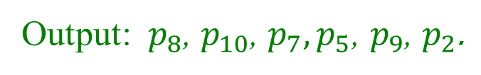


The Convex Hull Problem
Input: a set $P = \{ p_{1} , p_{2} , …, p_{n} \}$of points
Output: a list of vertices of CH($P$) in counterclockwise order.
(direction of traversal about the
outward axis with the interior
on the left)
Example
$$p_{5}$$
$$p_{9}$$
$$p_{6}$$
$$p_{7}$$
$$p_{1}$$
$$p_{2}$$
$$p_{4}$$
$$p_{3}$$
$$p_{10}$$
$$p_{8}$$
Output: $p_{8}$, $p_{10}$, $p_{7},p_{5}\text{, }p_{9}\text{, }p_{2}\text{.}$

Slide 16
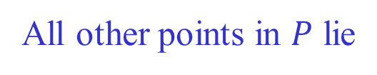

Edges of a Convex Hull
For every edge with both endpoints $p, q ε P$.
All other points in $P$ lie
to the same side of the line passing through $p$ and $q$
q
p

Slide 17
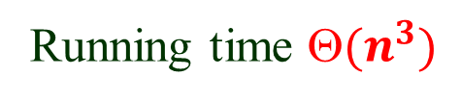
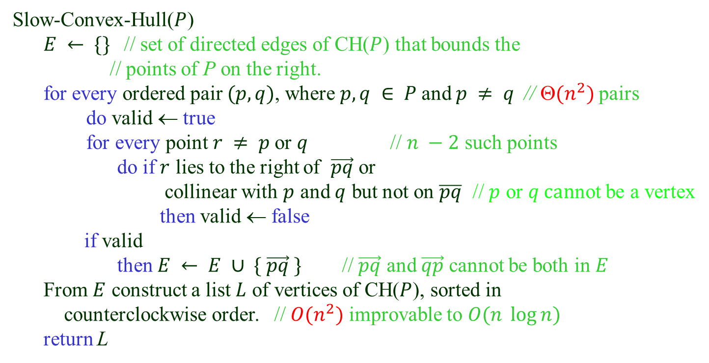



A Slow Convex Hull Algorithm
Slow-Convex-Hull($P$)
$E ← \{\}$// set of directed edges of CH($P$) that bounds the
// points of P on the right.
for every ordered pair $(p, q)$, where $p, q ∈ P$and $p ≠ q$// $(n^{2})$pairs
do valid ← true
for every point $r ≠ p$or $q$ // $n −2$ such points
do if $r$ lies to the right of $\vec{pq}$ or
collinear with $p$ and $q$ but not on $\overline{pq}$ // $p$ or $q can$not be a vertex
then valid ← false
if valid
then $E ← E ∪ \{ \vec{pq} \}$// $\vec{pq}$ and $\vec{qp}$ cannot be both in$E$
From $E$ construct a list $L$ of vertices of CH($P$), sorted in
counterclockwise order. // $O(n^{2})$ improvable to $O(n \log{n})$
return L
$$q$$
$$p$$
$$r$$
Running time $(n^{3})$

Slide 18

Graham’s Scan (1972)
1) Select the point with the smallest $y$ coordinate.
$$p_{0}$$
This point must be a vertex of the convex hull.

Slide 19

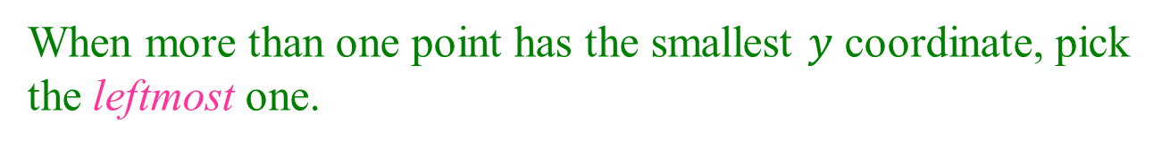
Tie Breaking (1)
When more than one point has the smallest $y$ coordinate, pick
the leftmost one.
$$p_{0}$$

Slide 20




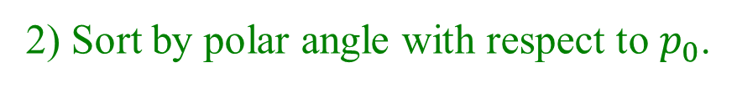







Sorting by Polar Angle
2) Sort by polar angle with respect to $p_{0}$.
$$p_{9}$$
$$p_{6}$$
$$p_{4}$$
$$p_{11}$$
$$p_{7}$$
$$p_{3}$$
$$p_{8}$$
$$p_{10}$$
$$p_{5}$$
$$p_{2}$$
$$p_{1}$$
$$p_{0}$$
$$p_{0}$$
Labels are in the polar angle order.

Slide 21






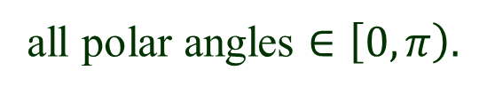

No Polar Angle Evaluation
$p_{0}$ is the lowest (and leftmost)
all polar angles $∈\left[0, π\right).$
$Use cross product!$
$$p_{i}< p_{j}$$
if
$$\vec{p_{0}p_{i}} ×\vec{p_{0}p_{j}}>0$$
$$p_{i}$$
$$p_{j}$$
$$p_{0}$$

Slide 22









Tie Breaking (2)
What if ${p_{0}, p}_{i}, p_{j} are on the same line?$
Order them by distance from $p_{0}$.
$$p_{i}< p_{j}$$
if and
$$\vec{p_{0}p_{i}} ×\vec{p_{0}p_{j}}=0$$
$$\left|\vec{p_{0}p_{i}}\right|<|\vec{p_{0}p_{j}}|$$
$$p_{j}$$
No square roots.
Use dot product!
$$p_{i}$$
$$p_{0}$$
$$\vec{p_{0}p_{i}}∙\vec{p_{0}p_{i}}<\vec{p_{0}p_{j}}∙\vec{p_{0}p_{j}}$$

Slide 23




Stack Initialization
3) Visit$points in the scanned order$.
Use a stack and push the first three points onto it.
$$p_{9}$$
$$p_{6}$$
$$p_{4}$$
$$p_{11}$$
$$p_{7}$$
$$S$$
$$p_{3}$$
$$p_{2}$$
$$p_{8}$$
$$p_{10}$$
$$p_{5}$$
$$p_{1}$$
$$p_{2}$$
$$p_{1}$$
$$p_{0}$$
$$p_{0}$$

Slide 24
Make a right turn at $p_{2}$.
Pop out $p_{2}$.
$$p_{9}$$
$$p_{6}$$
$$p_{4}$$
$$p_{11}$$
$$p_{7}$$
$$S$$
$$p_{3}$$
$$p_{2}$$
$$p_{8}$$
$$p_{10}$$
$$p_{5}$$
$$p_{1}$$
$$p_{2}$$
$$p_{1}$$
$$p_{0}$$
$$p_{0}$$

Slide 25
Make a right turn at $p_{2}$.
Pop out $p_{2}$.
$$p_{9}$$
$$p_{6}$$
$$p_{4}$$
$$p_{11}$$
$$p_{7}$$
$$p_{3}$$
$$S$$
$$p_{8}$$
$$p_{10}$$
$$p_{5}$$
$$p_{1}$$
$$p_{2}$$
$$p_{1}$$
$$p_{0}$$
$$p_{0}$$

Slide 26

Then, push $p_{3}$ onto the stack.
$$p_{9}$$
$$p_{6}$$
$$p_{4}$$
$$p_{11}$$
$$p_{7}$$
$$S$$
$$p_{3}$$
$$p_{3}$$
$$p_{8}$$
$$p_{10}$$
$$p_{5}$$
$$p_{1}$$
$$p_{2}$$
$$p_{1}$$
$$p_{0}$$
$$p_{0}$$

Slide 27
Make a right turn at $p_{3}$.
Pop out $p_{3}$.
$$p_{9}$$
$$p_{6}$$
$$p_{4}$$
$$p_{11}$$
$$p_{7}$$
$$S$$
$$p_{3}$$
$$p_{3}$$
$$p_{8}$$
$$p_{10}$$
$$p_{5}$$
$$p_{1}$$
$$p_{2}$$
$$p_{1}$$
$$p_{0}$$
$$p_{0}$$

Slide 28
Make a right turn at $p_{3}$.
Pop out $p_{3}$.
$$p_{9}$$
$$p_{6}$$
$$p_{4}$$
$$p_{11}$$
$$p_{7}$$
$$p_{3}$$
$$S$$
$$p_{8}$$
$$p_{10}$$
$$p_{5}$$
$$p_{1}$$
$$p_{2}$$
$$p_{1}$$
$$p_{0}$$
$$p_{0}$$

Slide 29
Push $p_{4}$ onto the stack.
$$p_{9}$$
$$p_{6}$$
$$p_{4}$$
$$p_{11}$$
$$p_{7}$$
$$S$$
$$p_{3}$$
$$p_{4}$$
$$p_{8}$$
$$p_{10}$$
$$p_{5}$$
$$p_{1}$$
$$p_{2}$$
$$p_{1}$$
$$p_{0}$$
$$p_{0}$$

Slide 30

Make a left turn at $p_{4}$.
$$p_{9}$$
$$p_{6}$$
$$p_{4}$$
$$p_{11}$$
$$p_{7}$$
$$S$$
$$p_{3}$$
$$p_{4}$$
$$p_{8}$$
$$p_{10}$$
$$p_{5}$$
$$p_{1}$$
$$p_{2}$$
$$p_{1}$$
$$p_{0}$$
$$p_{0}$$

Slide 31

P$ush p_{5}$ onto the stack.
$$p_{9}$$
$$p_{6}$$
$$S$$
$$p_{4}$$
$$p_{11}$$
$$p_{7}$$
$$p_{5}$$
$$p_{3}$$
$$p_{4}$$
$$p_{8}$$
$$p_{10}$$
$$p_{5}$$
$$p_{1}$$
$$p_{2}$$
$$p_{1}$$
$$p_{0}$$
$$p_{0}$$

Slide 32
Make a right turn at $p_{5}$.
Pop it out.
$$p_{9}$$
$$p_{6}$$
$$p_{4}$$
$$p_{11}$$
$$S$$
$$p_{7}$$
$$p_{3}$$
$$p_{4}$$
$$p_{8}$$
$$p_{10}$$
$$p_{5}$$
$$p_{1}$$
$$p_{2}$$
$$p_{1}$$
$$p_{0}$$
$$p_{0}$$

Slide 33

P$ush p_{6}$ onto the stack.
$$p_{9}$$
$$p_{6}$$
$$S$$
$$p_{4}$$
$$p_{11}$$
$$p_{7}$$
$$p_{6}$$
$$p_{3}$$
$$p_{4}$$
$$p_{8}$$
$$p_{10}$$
$$p_{5}$$
$$p_{1}$$
$$p_{2}$$
$$p_{1}$$
$$p_{0}$$
$$p_{0}$$

Slide 34

P$ush p_{7}$ onto the stack.
$$S$$
$$p_{9}$$
$$p_{6}$$
$$p_{4}$$
$$p_{7}$$
$$p_{11}$$
$$p_{7}$$
$$p_{6}$$
$$p_{3}$$
$$p_{4}$$
$$p_{8}$$
$$p_{10}$$
$$p_{5}$$
$$p_{1}$$
$$p_{2}$$
$$p_{1}$$
$$p_{0}$$
$$p_{0}$$

Slide 35
P$ush p_{8}$ onto the stack.
$$S$$
$$p_{6}$$
$$p_{8}$$
$$p_{9}$$
$$p_{4}$$
$$p_{7}$$
$$p_{11}$$
$$p_{7}$$
$$p_{6}$$
$$p_{3}$$
$$p_{4}$$
$$p_{8}$$
$$p_{10}$$
$$p_{5}$$
$$p_{1}$$
$$p_{2}$$
$$p_{1}$$
$$p_{0}$$
$$p_{0}$$

Slide 36

Make a right turn at $p_{8}$.
Pop it out.
$$S$$
$$p_{6}$$
$$p_{8}$$
$$p_{9}$$
$$p_{4}$$
$$p_{7}$$
$$p_{11}$$
$$p_{7}$$
$$p_{6}$$
$$p_{3}$$
$$p_{4}$$
$$p_{8}$$
$$p_{10}$$
$$p_{5}$$
$$p_{1}$$
$$p_{2}$$
$$p_{1}$$
$$p_{0}$$
$$p_{0}$$

Slide 37

Make a right turn at $p_{7}$.
Pop it out.
$$S$$
$$p_{9}$$
$$p_{6}$$
$$p_{4}$$
$$p_{7}$$
$$p_{11}$$
$$p_{7}$$
$$p_{6}$$
$$p_{3}$$
$$p_{4}$$
$$p_{8}$$
$$p_{10}$$
$$p_{5}$$
$$p_{1}$$
$$p_{2}$$
$$p_{1}$$
$$p_{0}$$
$$p_{0}$$

Slide 38


Finally, $push p_{9}$ onto the stack.
$$S$$
$$p_{9}$$
$$p_{6}$$
$$p_{4}$$
$$p_{9}$$
$$p_{11}$$
$$p_{7}$$
$$p_{6}$$
$$p_{3}$$
$$p_{4}$$
$$p_{8}$$
$$p_{10}$$
$$p_{5}$$
$$p_{1}$$
$$p_{2}$$
$$p_{1}$$
$$p_{0}$$
$$p_{0}$$

Slide 39

P$ush p_{10}$ onto the stack.
$$S$$
$$p_{6}$$
$$p_{10}$$
$$p_{9}$$
$$p_{4}$$
$$p_{9}$$
$$p_{11}$$
$$p_{7}$$
$$p_{6}$$
$$p_{3}$$
$$p_{4}$$
$$p_{8}$$
$$p_{10}$$
$$p_{5}$$
$$p_{1}$$
$$p_{2}$$
$$p_{1}$$
$$p_{0}$$
$$p_{0}$$

Slide 40

Pop$p_{10}$ out.
P$ush p_{11}$ onto the stack.
$$S$$
$$p_{6}$$
$$p_{11}$$
$$p_{9}$$
$$p_{4}$$
$$p_{9}$$
$$p_{11}$$
$$p_{7}$$
$$p_{6}$$
$$p_{3}$$
$$p_{4}$$
$$p_{8}$$
$$p_{10}$$
$$p_{5}$$
$$p_{1}$$
$$p_{2}$$
$$p_{1}$$
$$p_{0}$$
$$p_{0}$$

Slide 41
Finish
S
$$p_{6}$$
$$p_{11}$$
$$p_{9}$$
$$p_{4}$$
$$p_{9}$$
$$p_{11}$$
$$p_{7}$$
$$p_{6}$$
$$p_{3}$$
$$p_{4}$$
$$p_{8}$$
$$p_{10}$$
$$p_{5}$$
$$p_{1}$$
$$p_{2}$$
$$p_{1}$$
$$p_{0}$$
$$p_{0}$$

Slide 42




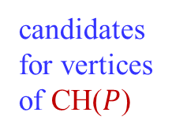



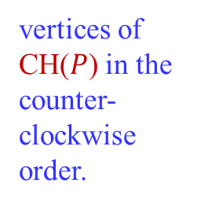


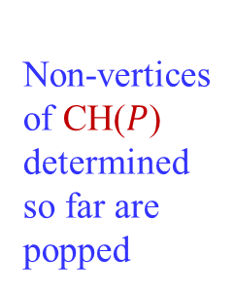

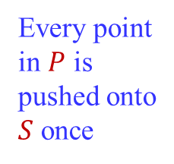

Graham’s Scan
candidates
for vertices
of CH($P$)
$$p_{k}$$
Non-vertices
of CH($P$)
determined
so far are
popped
$$p_{j}$$
$$p_{l}$$
finish
start
Every point
in $P$ is
pushed onto
$S$ once
$$p_{j}$$
$$p_{i}$$
$$p_{i}$$
$$p_{s}$$
$$p_{2}$$
$$p_{i}$$
•
•
•
$$p_{1}$$
•
•
•
•
•
•
•
•
$$p_{0}$$
$$p_{0}$$
•
$$p_{0}$$
$$p_{0}$$
$$p_{0}$$
vertices of
CH($P$) in the
counter-
clockwise
order.

Slide 43
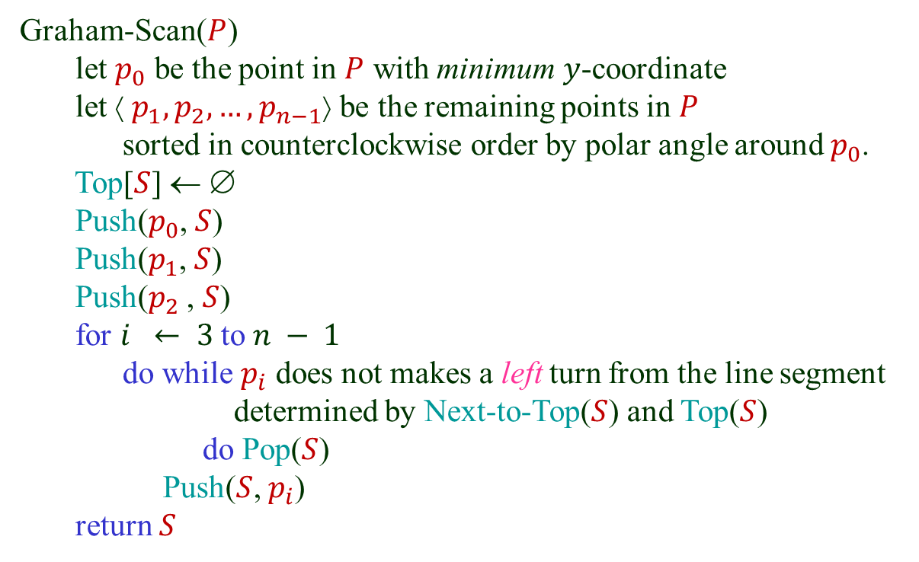
The Graham Scan Algorithm
Graham-Scan($P$)
let $p_{0}$ be the point in $P$ with minimum $y$-coordinate
let ⟨ $p_{1},p_{2}, …,p_{n−1}$⟩ be the remaining points in $P$
sorted in counterclockwise order by polar angle around $p_{0}$.
Top[$S$] ← ∅
Push($p_{0}$, $S$)
Push($p_{1}$, $S$)
Push($p_{2}$ , $S$)
for $i ← 3$to $n − 1$
do while $p_{i}$ does not makes a left turn from the line segment
determined by Next-to-Top($S$) and Top($S$)
do Pop($S$)
Push($S$, $p_{i}$)
return $S$

Slide 44
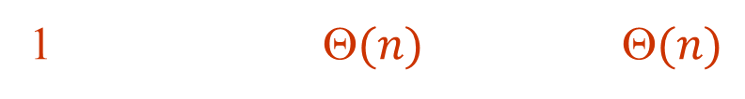

Running time
#operations time / operation total
Finding
1 $(n)$ $(n)$
$$p_{0}$$
Sorting 1 $O(n \log{n})$ O($n \log{n}$)
Push $n$ $O(1) (n)$
Pop $ n − 2 O(1) O(n)$
Why?
The running time of Graham’s Scan is $O(n \log{n}).$

Slide 45

Jarvis’ March
A “package wrapping” technique
$$p_{4}$$
(smallest polar
angle w.r.t. $p_{2}$ )
(highest point)
$$p_{3}$$
Left
chain
$$p_{2}$$
(smallest polar
angle w.r.t. $p_{1}$ )
(smallest polar
angle w.r.t. $p_{4}$ )
Right
chain
$$p_{5}$$
$$p_{1}$$
(smallest polar
angle w.r.t. $p_{0}$ )
(smallest polar
angle w.r.t. $p_{5}$ )
$$p_{6}$$
$$p_{0}$$
(lowest point)

Slide 46
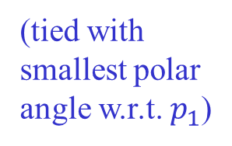

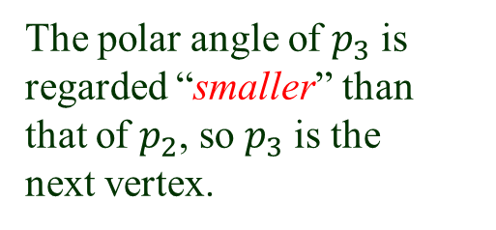
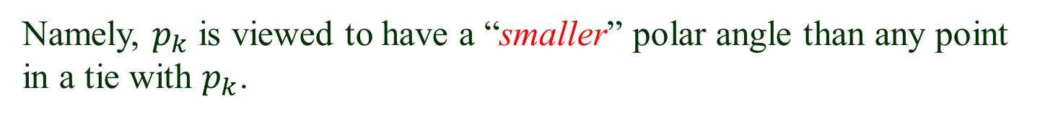
Tie Breaking
What if multiple points attain the smallest polar angle w.r.t. $p_{i}$?
Choose the one (say, $p_{k}$) furthest away from $p_{i} to be the next vertex.$
Namely, $p_{k}$ is viewed to have a “smaller” polar angle than any point in a tie with $p_{k}$.
$$p_{3}$$
(tied with
smallest polar
angle w.r.t. $p_{1}$)
$$p_{2}$$
The polar angle of $p_{3}$ is regarded “smaller” than
that of $p_{2}$, so $p_{3}$ is the
next vertex.
$$p_{1}$$
(smallest polar
angle w.r.t. $p_{0}$)
$$p_{0}$$
(lowest point)

Slide 47
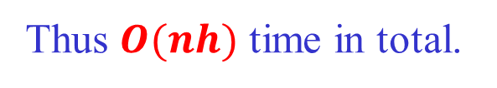
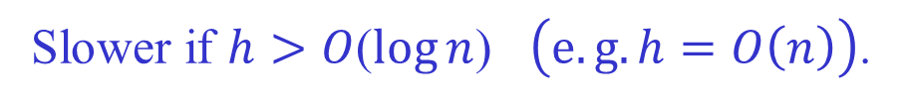
Running Time of Jarvis’s March
Let h be the number of vertices of the convex hull.
For each vertex, finding the point with the minimum
polar angle, that is, the next vertex, takes time O(n).
Thus $O(nh)$ time in total.
h depends on the input points.
Faster than Graham’s scan if$h<O$($\log{n}$)$\left(e.g. h=O\left(1\right)\right).$
Slower if $h>O$($\log{n}$) $\left(e.g. h=O\left(n\right)\right)$.

